Slide 1
Supervised and Unsupervised Methods for Stock Trend Forecasting
Nicole Powell, SimonY.Foo, and Mark Weatherspoon
40th Southeastern Symposium on SystemTheory
University of New Orleans
New Orleans, LA, USA,March 16-18, 2008
Presenter: Tsung-Jung Tsai (蔡宗容)
Date: July 30, 2008

Slide 2
Abstract (1/2)
Stock forecasting is a major component of any finance institution because predictions of future prices, indices, volumes and many more values are often incorporated into the economic decision-making process. Although there are many different approaches out there, this paper will compare unsupervised classification techniques such as k-means clustering with supervised learning algorithms such as support vector machines (SVMs).

Slide 3
Abstract (2/2)
In our study, a list of stock prices taken from historical data of the S&P 500 is used as our testbed. These prices will be categorized as increasing or decreasing in price on a weekly basis. The goal of this study is to determine the best method for forecasting the trend of stock prices.

Slide 4
The task of stock trend prediction
For recognizing specified patterns, there has been much work done in this area however no real successful formula has been developed.
From year to year, many stockholders would like to be able to know if their stock price will increase or decrease.
In turn this prediction may help them in the decision to buy more or sell the stock they currently have.

Slide 5
Data collection
The data used in the analysis contained the weekly prices of Dow 30 stocks.
This data obtained from Yahoo! Finance.
Use two years of data to identify the performance.
  The first year, 2005, will be used for training
  The second year, 2006, for validation.

Slide 6
Some of the DJIA 30 stocks
公司 | 行業 | 股票代號
惠普公司 | 電腦硬體、印表機 | HPQ
國際商用機器公司 | 硬體、軟體和服務 | IBM
英特爾 | 微處理器 | INTC
微軟 | 軟體 | MSFT
迪士尼 | 娛樂業 | DIS
花旗集團 | 金融服務 | C
通用汽車 | 汽車 | GM
AT&T | 電訊 | T
可口可樂公司 | 飲料 | KO
麥當勞 | 快餐、特許經營 | MCD
沃爾瑪 | 零售業 | WMT
3M公司 | 原料、電子 | MMM

Slide 7
Problem formulation
There are nine attributed associated to each stock.
They are raw numerical price values as follows:
  open, high, low, close,
  volume, volume increase or decrease,
  adjusted close, adjusted close increase or decrease,
  Overall increase (Class +1) or decrease (Class -1) over the 52 weeks

Slide 8
Problem formulation (Cont.)
This problem is formulated as a two-class pattern recognition task.
The classification algorithms needed to simply determine if the stock price would increase or decrease based on the given data from the previous year.

Slide 9
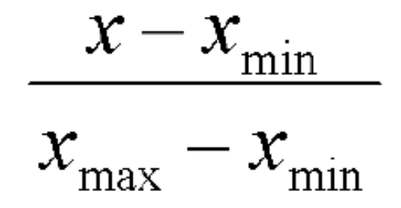
Methodology: K-means Clustering (1/4)
It is an unsupervised learning method.
Normalize the data
Principle component analysis (PCA) is used to reduce the number of dimensions of a data set to “select” the components which have the biggest effect.
▼Skip next

Slide 10
Methodology: K-means Clustering (2/4)

Slide 11
Methodology: K-means Clustering (2/4)

Slide 12
Methodology: K-means Clustering (2/4)

Slide 13
Methodology: K-means Clustering (3/4)
The basic steps for K-means clustering are as follows:
  Initialize the centroids, which should be equal to the number of classes (targets) in the data set.
  Determine the distance from each object to each of the centroids.
  Select the minimum distance and group each object based on the minimum distance.
  Continue the previous steps until none of the data points are reassigned.
▲Skip previous

Slide 14
Methodology: K-means Clustering (4/4)
The distance metric used were
  Euclidean
  Manhattan
  Chebyshev
  Minkowski
  Canberra

Slide 15
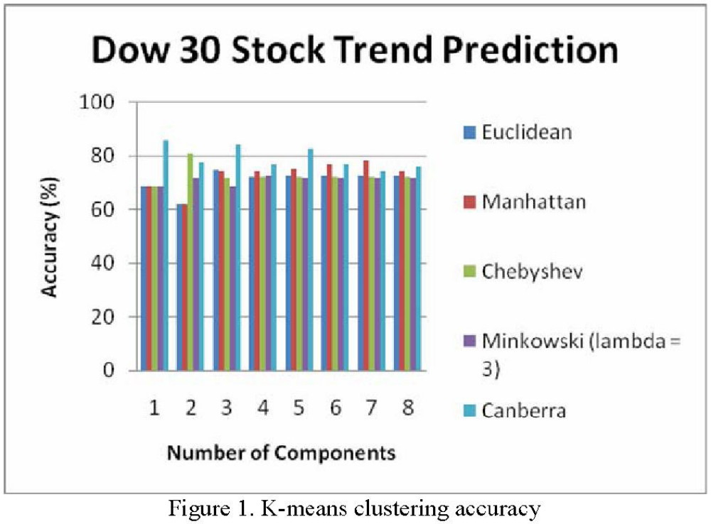

Slide 16
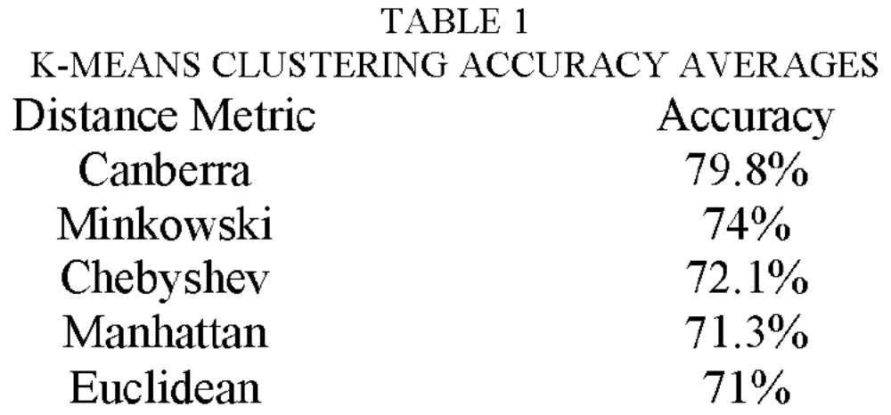

Slide 17
Methodology: Support Vector Machines
They are a supervised pattern classification technique which map input vectors to a higher dimensional space.

Slide 18
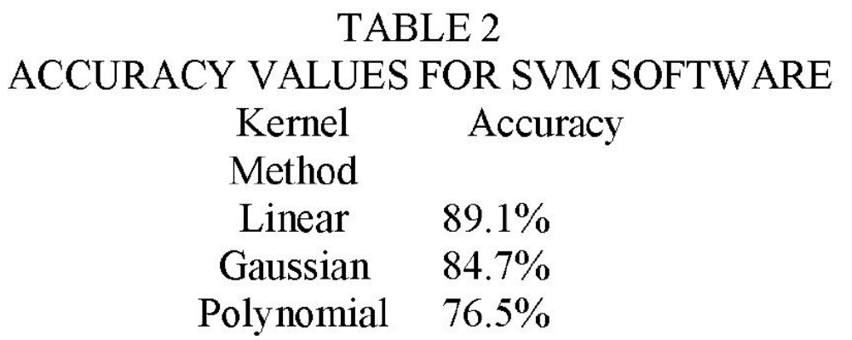

Slide 19
Conclusion for an unsupervised method
It can be concluded that an unsupervised method can be used for stock trend forecasting.
Because unsupervised methods find patterns in data that is usually seen as uncorrected.

